Slide 1

Decision Trees
Justin Grosz

Slide 2
Today’s Agenda
Review Last Week’s Homework
Decision Trees
Random Forest
Gradient Boosting
In Class Work

Slide 3

GLM HW

Slide 4
Review Of week 3

Slide 5
Decision Trees

Slide 6
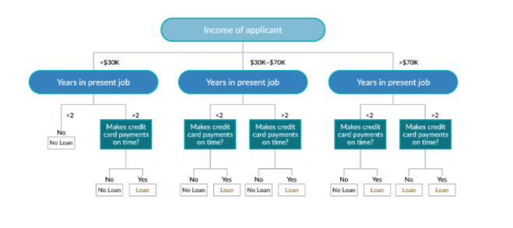
Decision Trees
Decision Trees are popular because they offer a high level overview of what is important when solving a predictive analytics problem, and that helps facilitate prioritizing. These rule-based models are also popular because techniques have been developed to create ensemble models, models made up of multiple algorithms.
A decision tree, as the name implies, helps make informed decisions by breaking a problem down into a series of questions (Links to an external site.). For example, to determine if an applicant should be granted a loan, a simplified decision tree might work as follows.

Slide 7

Understanding Of How Decision Trees Are Built Part 1
Decision trees can help solve more complex problems by creating an ensemble, or combination, of trees and by adding probabilities and values to outcomes of decisions. For example, a decision tree can be used to decide whether a company should build a large or a small processing plant to manufacture a new product whose marketability is unknown (Links to an external site.).
It is important to understand how decision trees are composed. Questions to answer when building a decision tree include what questions, or decisions, should form the nodes, in what order should those decisions be posed, and how reliable is the data we are basing our decision on? Let’s look at two methodologies to assist us, entropy and the Gini Index.
Entropy, which is a measure of disorder and uncertainty, helps describe the sample. Since our goal is to make a decision, we want to minimize uncertainty, hence the lower the entropy, the better. Entropy applies to how nonuniform the data set is. If all the data in the set is the same, we would have a uniform set and low entropy. The more the dataset is varied, the higher the entropy. Higher entropy would imply higher impurity as the data is not uniform, or “pure.”

Slide 8
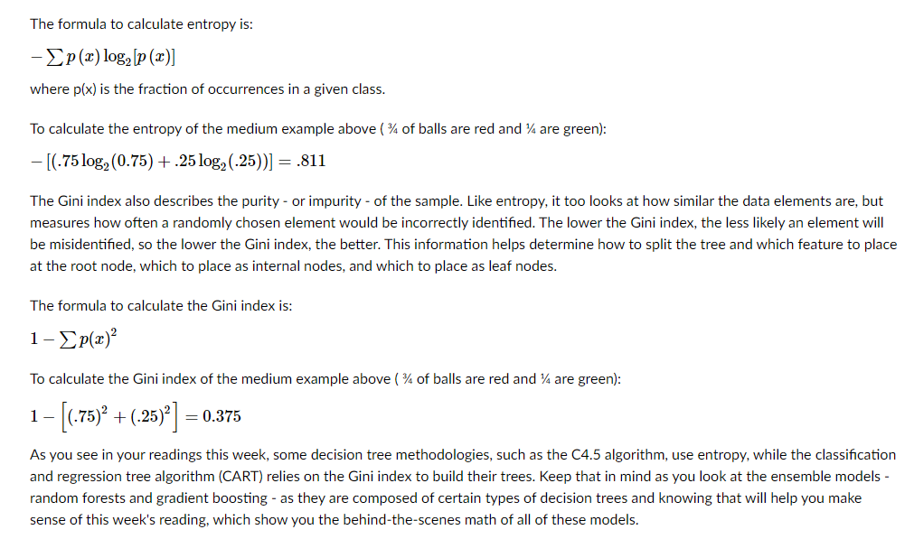
Calculating Decision Trees

Slide 9
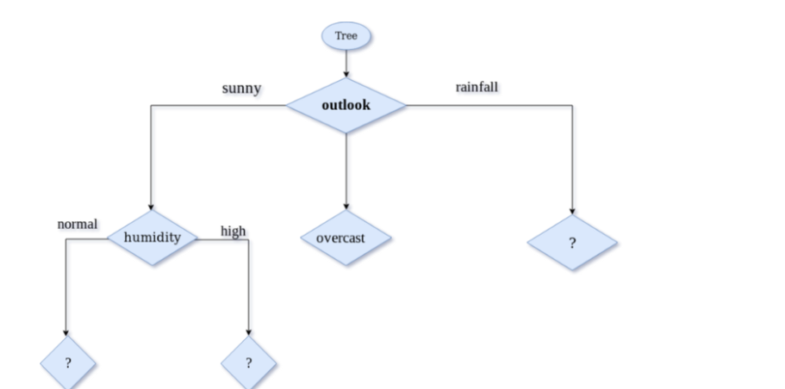
CART
Used For Regression & Logistic Problems
Binomial Tree Splits
Uses Gini Index As Max Function

Slide 10
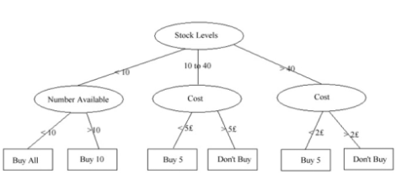
C 4.5
Handles Categorical & Numeric Values (C3 did not)
Uses Entrophy As Max Function

Slide 11
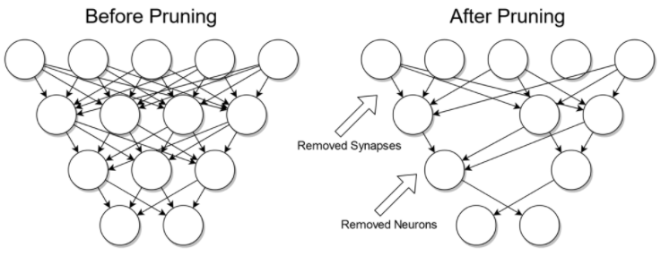
TREE PRUNING
Intro To Optimizing Decision Trees
Reduce Overfitting
Can Be Done Pre Or Post Of Running The Model

Slide 12
Random Forest

Slide 13
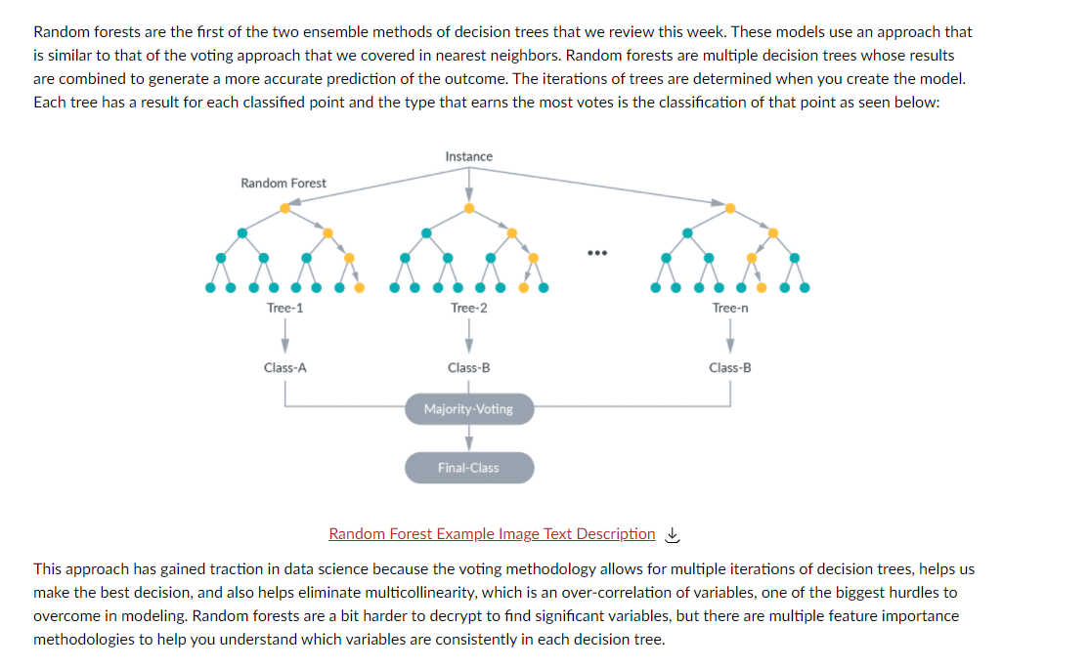
Random Forest

Slide 14
Advantages of Random Forest
Ensemble Model -> Strength of Multiple Models (Multiple Trees)
Takes Care Of Overfitting & Outliers
Improved Accuracy
Only downfall -> Not Good With Classification Data

Slide 15
Gradient Boosting

Slide 16
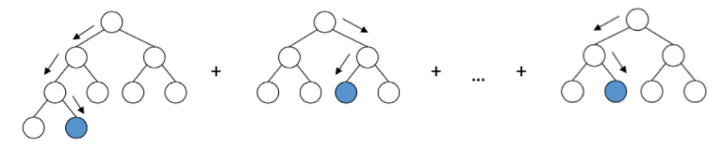
Gradient boosting
Another Ensemble Model But Known As Possibly One Of The Best
Typically Associated With CART Decision Trees
Used For Regression & Classification

Slide 17
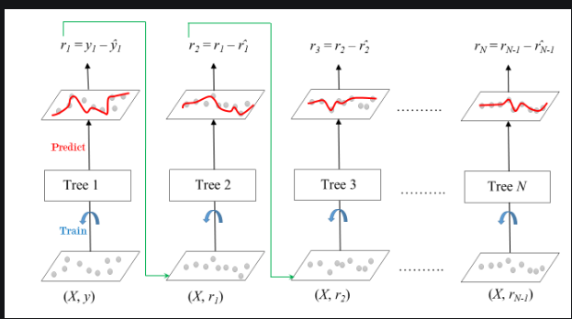
Gradient boosting: How Does It work
Takes An Ensemble Of Weak Learners -> Decision Trees
Decision Tree On Its Own, Not Typically The Strongest Model
Needs Some Optimization
Technique Focuses On Errors From All Models To Self Correct
Used For Many Kaggle Grandmaster Wins

Slide 18
Benchmarks

Slide 19
Benchmarking -> Comparing Models
Three Key Elements
Accuracy
Fit
Speed

Slide 20
In Class Example: Decision Tree Vs Logistic Regression

Slide 21
Loading data
import numpy as np
import pandas as pd
from sklearn import datasets
import matplotlib.pyplot as plt
from sklearn.linear_model import LogisticRegression
from sklearn.model_selection import train_test_split
from sklearn.metrics import classification_report, confusion_matrix,accuracy_score
from sklearn.linear_model import LogisticRegression
from sklearn import metrics
from sklearn.tree import DecisionTreeClassifier
from sklearn.ensemble import GradientBoostingClassifier
from sklearn import tree
import matplotlib.pyplot as plt
import matplotlib.image as pltimg
import statsmodels.api as smf
from sklearn.ensemble import RandomForestClassifier
#load dataset, using logistic regression to detect malignant tumors which is represented in target
bc = datasets.load_breast_cancer()
df = pd.DataFrame(np.c_[bc['data'], bc['target']],
columns= np.append(bc['feature_names'], ['target']))

Slide 22
Data Dictionary
radius (mean of distances from center to points on the perimeter)
texture (standard deviation of gray-scale values)
perimeter
area
smoothness (local variation in radius lengths)
compactness (perimeter^2 / area - 1.0)
concavity (severity of concave portions of the contour)
concave points (number of concave portions of the contour)
symmetry
fractal dimension (“coastline approximation” - 1)

Slide 23
Build Initial Model
y=df[['target']]
x=df.iloc[:, list(range(10))] #there are 30 variables so I limited it
x_train,x_test,y_train,y_test=train_test_split(x,y,test_size=0.2)
model = LogisticRegression(solver='liblinear', random_state=0).fit(x_train, y_train)
model.score(x_train, y_train)
Score??

Slide 24
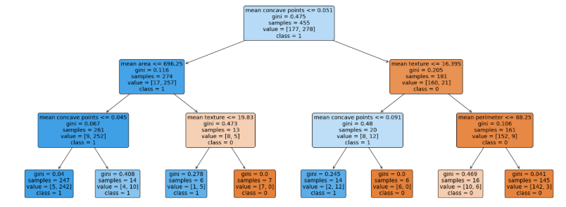
Now Decision Tree (Use CarT)
from sklearn.tree import DecisionTreeClassifier
treemodel = DecisionTreeClassifier(max_depth=3)
treemodel.fit(x_train,y_train)
plt.figure(figsize=(25,10))
plot=tree.plot_tree(treemodel,feature_names=x.columns.values.tolist(),class_names=['0','1'],filled=True,rounded=True,fontsize=14)
#Predict the response for test dataset
y_pred = model.predict(x_test)
print("Accuracy:",metrics.accuracy_score(y_test, y_pred))

Slide 25
In Class Example: Random Forest Vs Decision Trees

Slide 26
Random Forest Code
from sklearn.ensemble import RandomForestRegressor
rfclass=RandomForestClassifier(n_estimators=20,random_state=0)
rfclass.fit(x_train,y_train)
rfypred=rfclass.predict(x_test)
rfclass.score(x_test, y_test)

Slide 27
In Class Example: Gradient Boosting

Slide 28
Gradient Boosting Code
from sklearn.ensemble import GradientBoostingClassifier
gbclass=GradientBoostingClassifier(random_state=0)
gbclass.fit(x_train,y_train)
gbypred=gbclass.predict(x_test)
gbclass.score(x_test, y_test)

